Slide 1
Version Control with Git & Github
Jitender
CSB
(informatics group)

Slide 2
Schedule
Quick intro
Understand what version control is and why it’s worth using
Be able to set up git
Be able to use git to manage versions of files, seeing file history and changes
Understand what github is and how it allows collaborative working
Coffee Break 11’sh
* Git hands on exercises
Finish @ 12.30 1 pm if we over-run

Slide 3
Course Material
http://training.scicomp.jic.ac.uk/version_control_with_git_and_github.html
http://swcarpentry.github.io/git-novice
http://jlord.us/git-it/
https://github.com/gitbackspacer
https://guides.github.com/activities/hello-world/
https://kbroman.org/github_tutorial/
https://scitronboy.com/code/simple-git-github-tutorial

Slide 4

Motivation
“Piled Higher and Deeper” by Jorge Cham, http://www.phdcomics.com

Slide 5
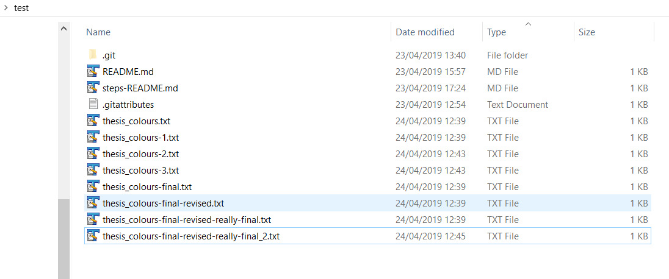
Why Git and GitHub exists ?
Working on something say a “thesis” or an “essay” – a project
Keep track of an entire history of things you working on
“save the previous one” Just in case
Dropbox/ googledocs
“not only for you” Collaborators

Slide 6
Keeping Track of Changes:
So it seems ridiculous to have multiple nearly-identical versions of the same document. There is some relief though when we use
Microsoft Word’s Track Changes, Google Docs’ version history,
Unlimited UNDO and REDO

Slide 7
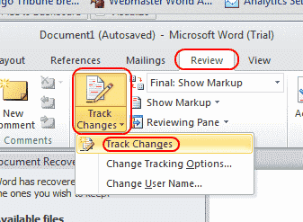
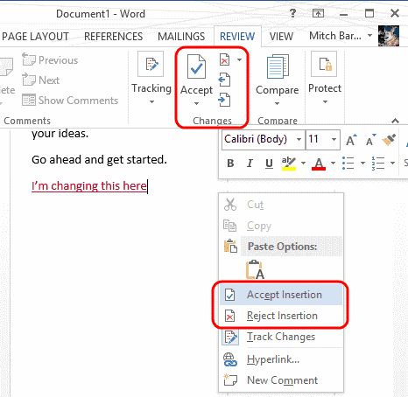
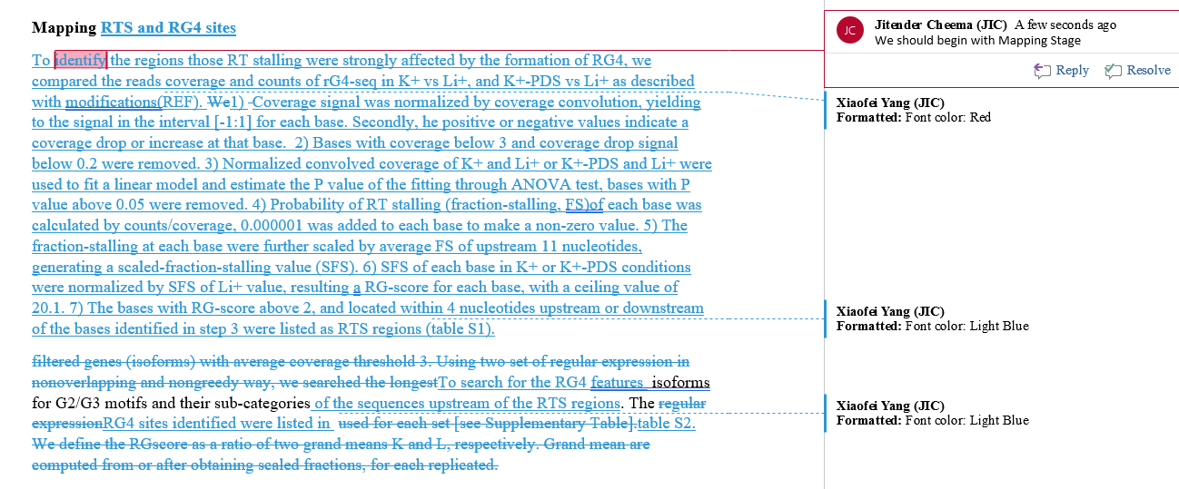
Git
Track changes
“type of Version control system enables you to record changes to files over time”
Similar to Words review

Slide 8
Git : "the stupid content tracker"
git means unpleasant person in British English slang
Git (/ɡɪt/^{[7]}) is a distributed version-control system for tracking changes in source code during software development.
It is designed for coordinating work among programmers, but it can be used to track changes in any set of files.
Goals include speed, data integrity, and support for distributed, non-linear workflows.
Created by Linus Torvalds in 2005 for development of the Linux kernel

Slide 9


GitHub
Microsoft paid $7.5 billion to takeover of code repository site Github
has more than ~ 85 million repositories hosted on GitHub, and
28 million developers contribute to them.
Gitlab and BitBucket

Slide 10
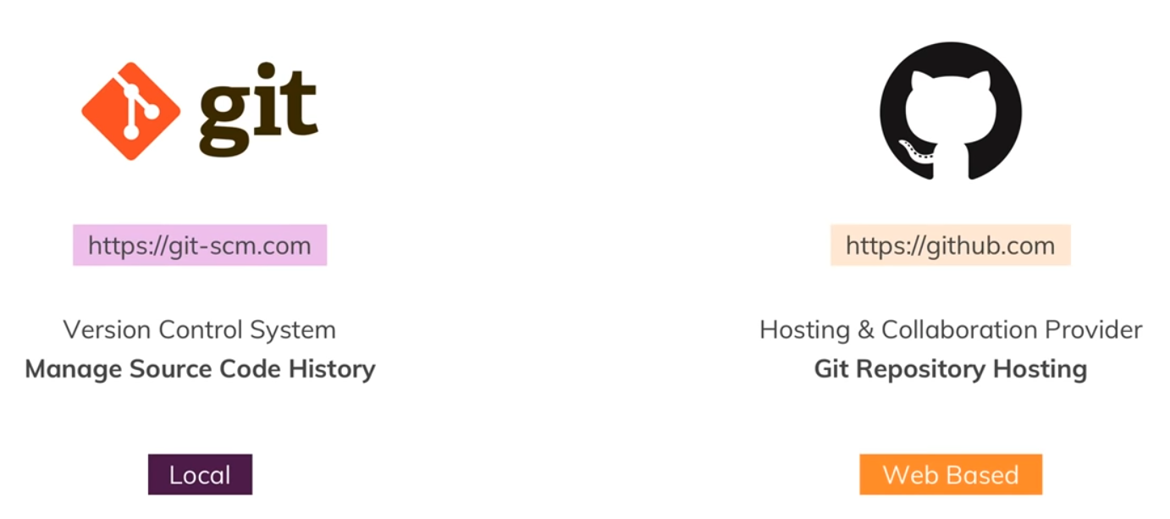
https://academind.com/

Slide 11
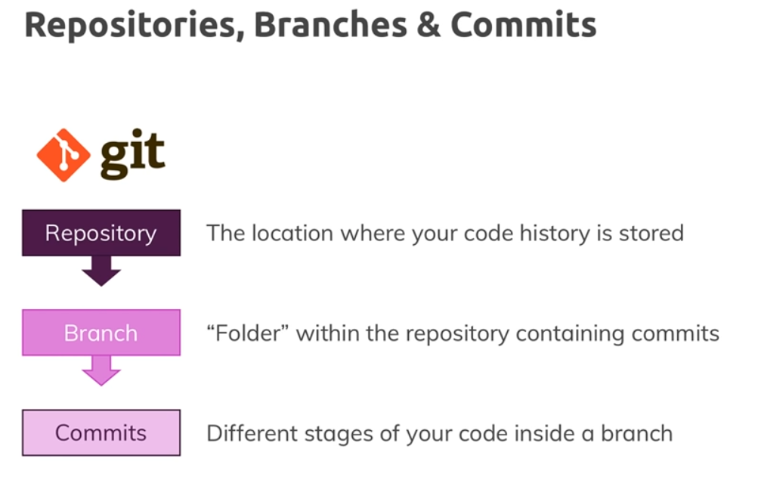
https://academind.com/

Slide 12
Why use git? Why use github?
Github is like facebook for programmers. (HUB)
-Everyone’s on there. You can look at what they’re working on and easily peruse their work(code) and make suggestions or changes.
-github, all of the code is easily inspected, as is its entire history.
-You don’t have to set up a git server.
* Version control is the only reasonable way
to keep track of changes in a code, manuscripts, presentations, and data analysis projects.
* Use git: you’ll have annotated each small change.
* Merging collaborators’ changes made easy.
- deal with a collaborator sending you modifications distributed across many files
- had to deal with two people having made changes to the same file at the same time? Painful.

Slide 13
Git/GitHub in simple words
System to keep track of the entire history of the project as well as allow many people to collaborate on the project together
It does not have a problem two people working on the same document at the same time
GIT is the actual VERSION CONTROL software. It is invented by the guy who invented LINUX ( Linus Torvalds)
GitHub is a website which does all the magic, and some (Hub)﻿

Slide 14
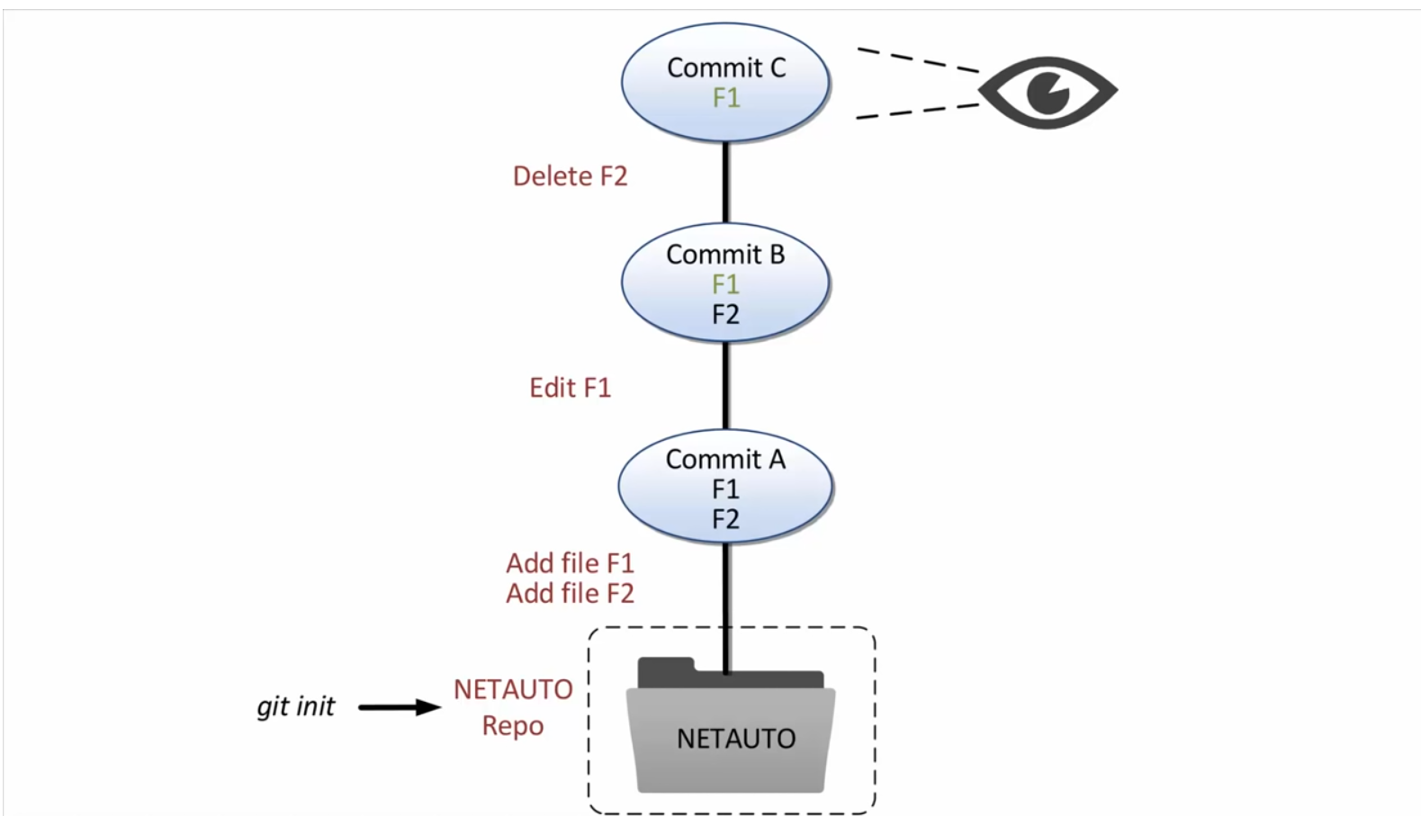
Courtesy: David Mahler

Slide 15
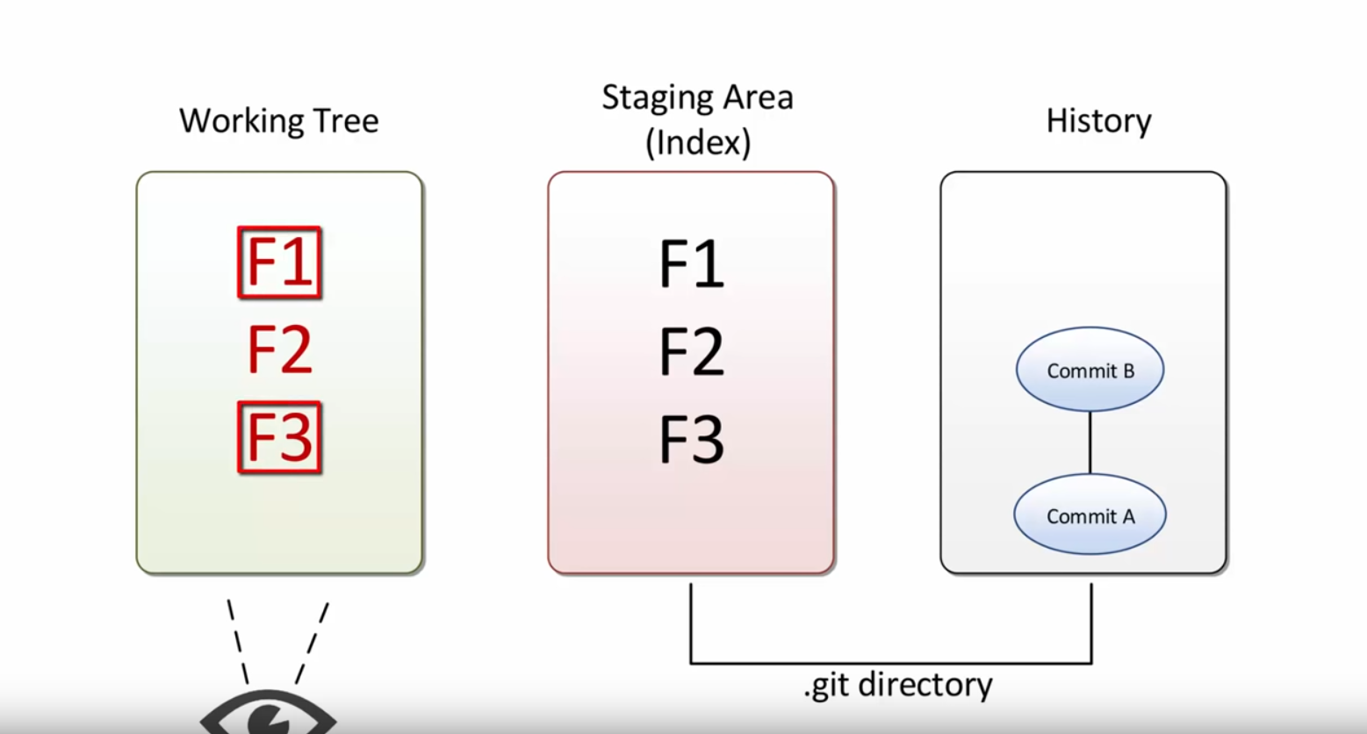

Slide 16
Lets Get started:
To turn an ordinary directory into a Git project,
* open up the command line
* cd into the project directory
and run
git init

Slide 17
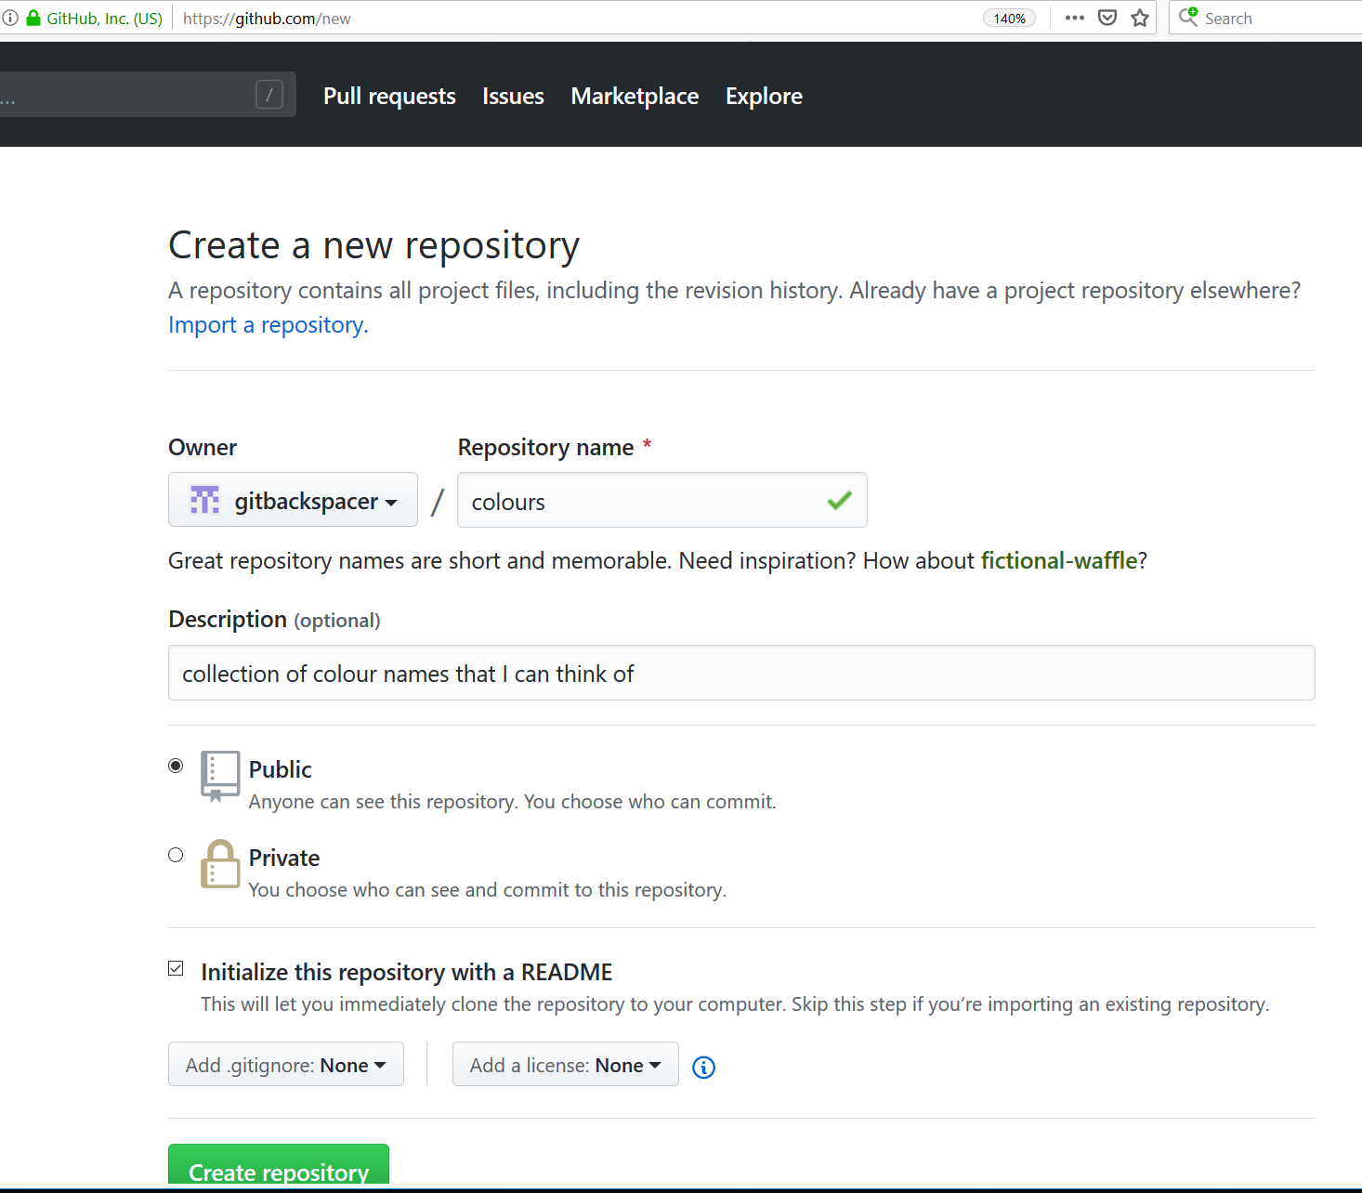
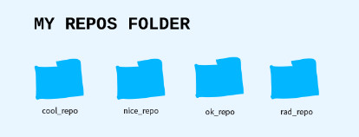
Github First https://github.com/gitbackspacer
Made an account
Create a repository (repo)
A repository is a collection of related items(it is a collection of files related to a software project).
You can imagine it as a project folder with all the relevant files inside of it. In fact, that's what it will look like on your computer anyways. Sometimes they're called "repos" for short

Slide 18
Repo
You tell Git what your project is and Git will start tracking all of the changes to that folder.
This makes it a Git repository: a folder of items being tracked by Git.
Git tracks when files are added, subtracted or even a single letter in a single file is changed.
All of this plus who did it and when is tracked by Git. In software, tracking changes like this is called version control.

Slide 19
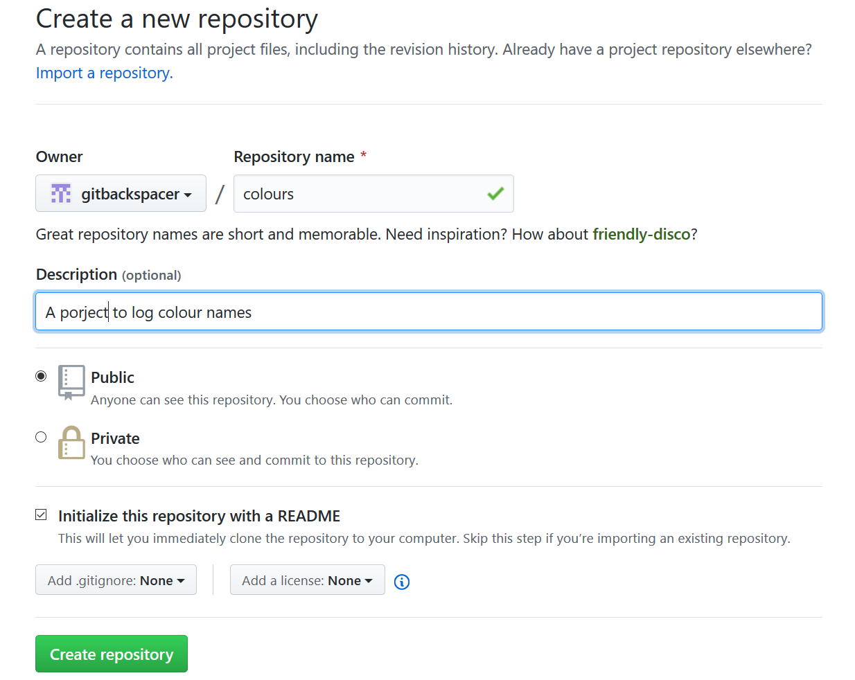
https://github.com/new

Slide 20
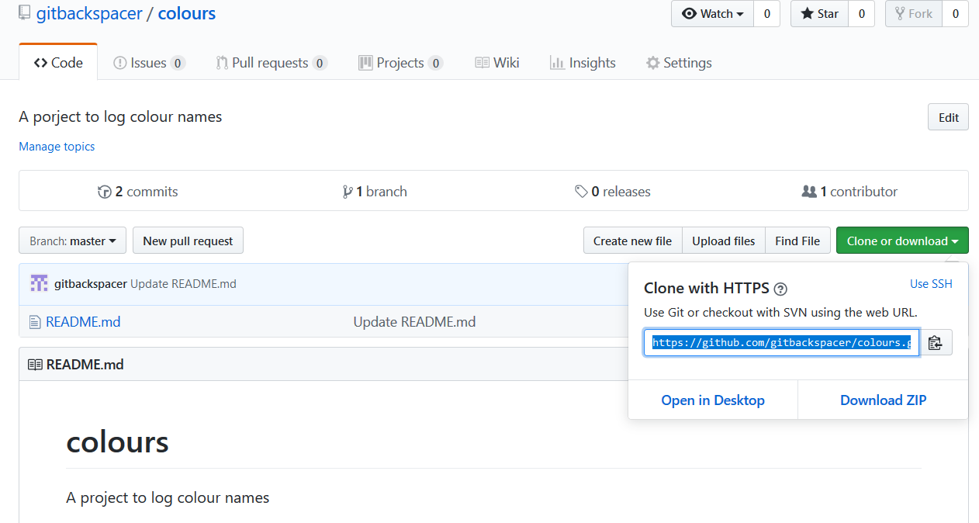

Slide 21
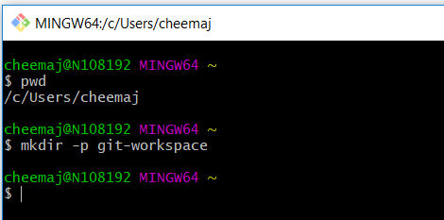
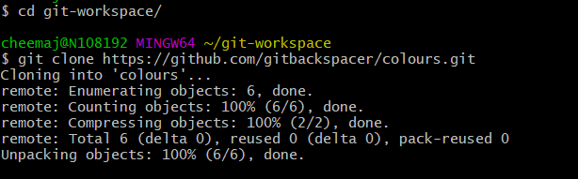
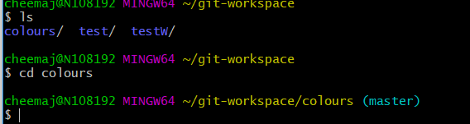
Copy back Locally

Slide 22
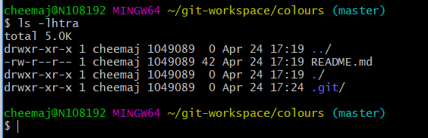
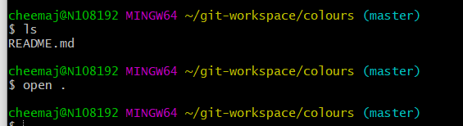
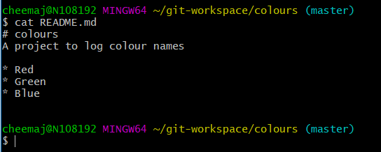
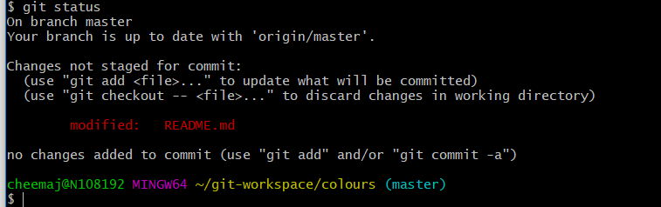

Slide 23
https://speakerd.s3.amazonaws.com/presentations/452113d0cb8c0131162302b4824706e4/20140601_github-kaigi-yunico.pdf

Slide 24
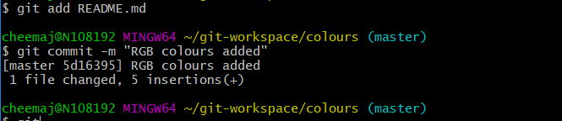
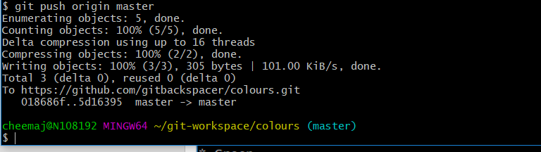
“add” and “push”

Slide 25
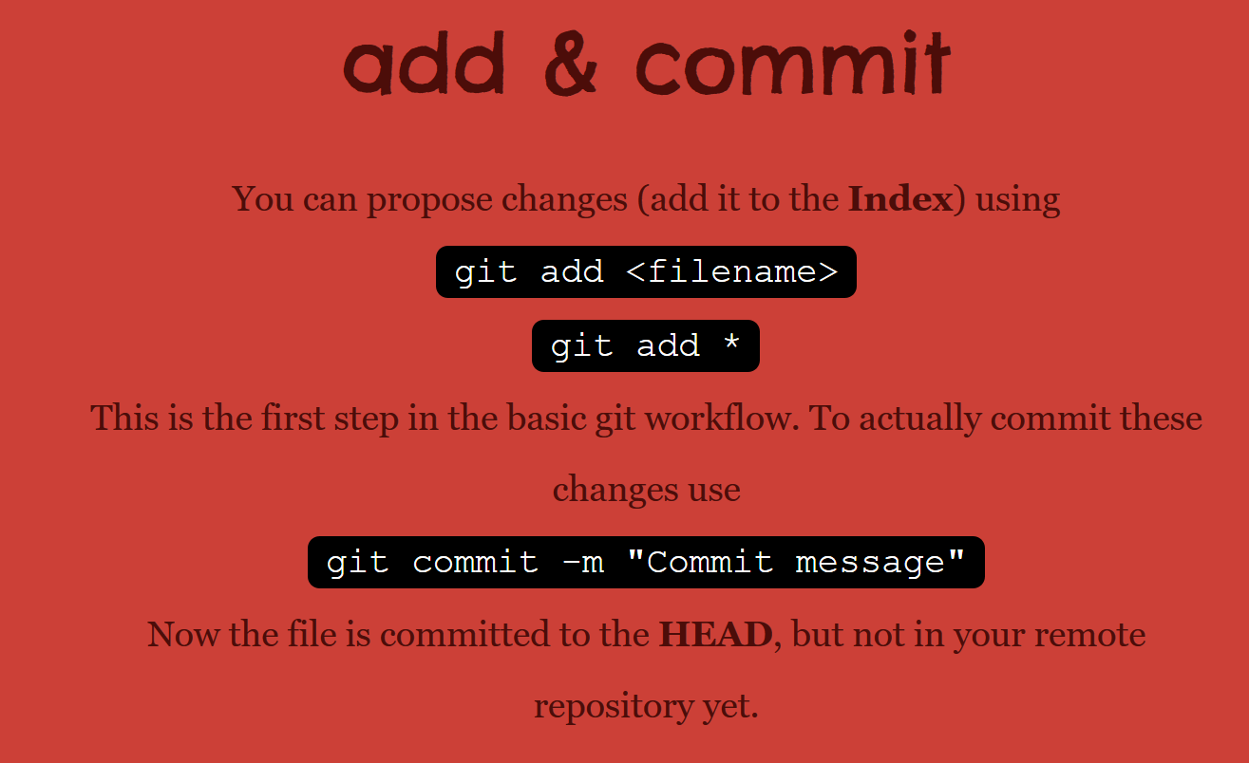

Slide 26
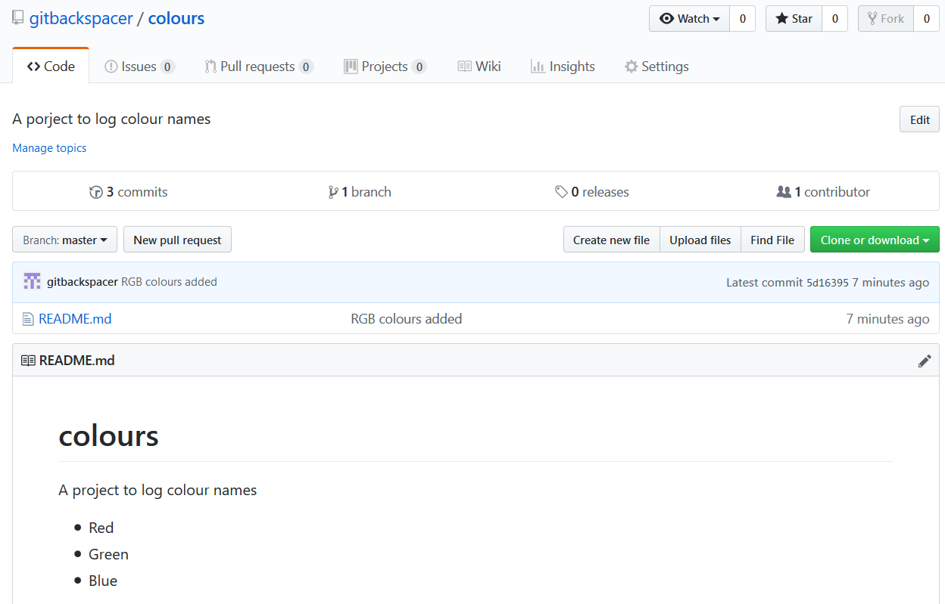
Has it updated on Github?

Slide 27
### repo remote url ###
https://github.com/gitbackspacer/colours.git
# prepare a local folder
mkdir -p git-workspace
# step into it
cd git-workspace/
# download the repo we made at github website
git clone https://github.com/gitbackspacer/colours.git
# see what is this directory or folder
ls
# step into colours folder
cd colours

Slide 28
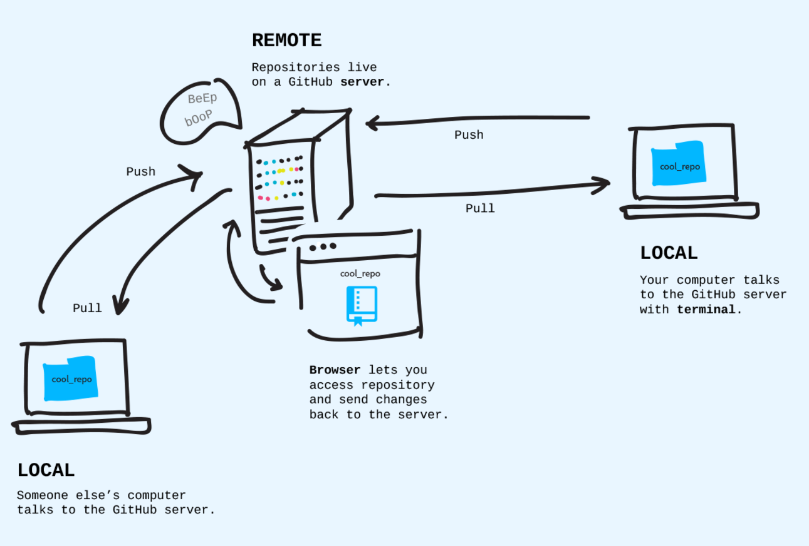
Where do repo lives?

Slide 29
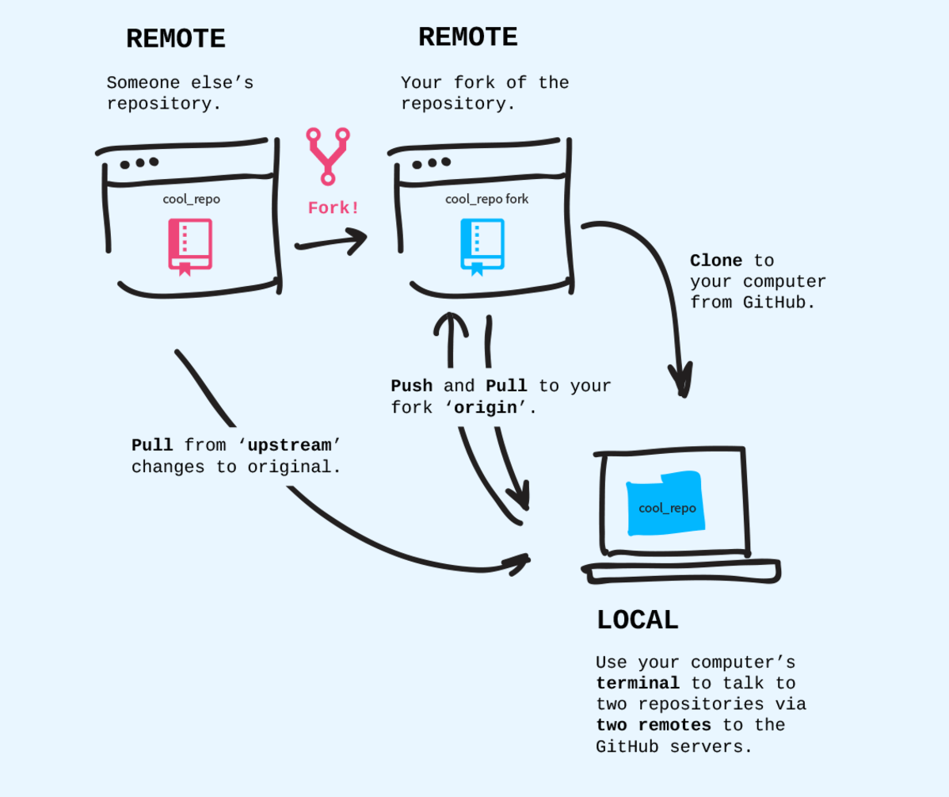
Fork and Clones

Slide 30
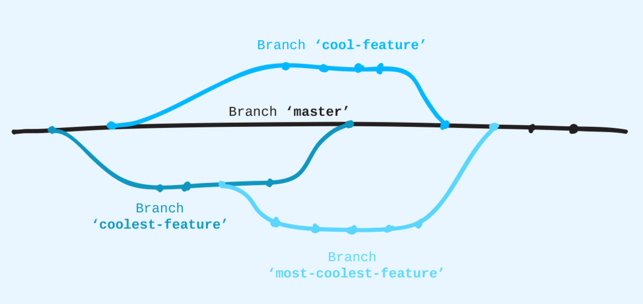
Branching off

Slide 31
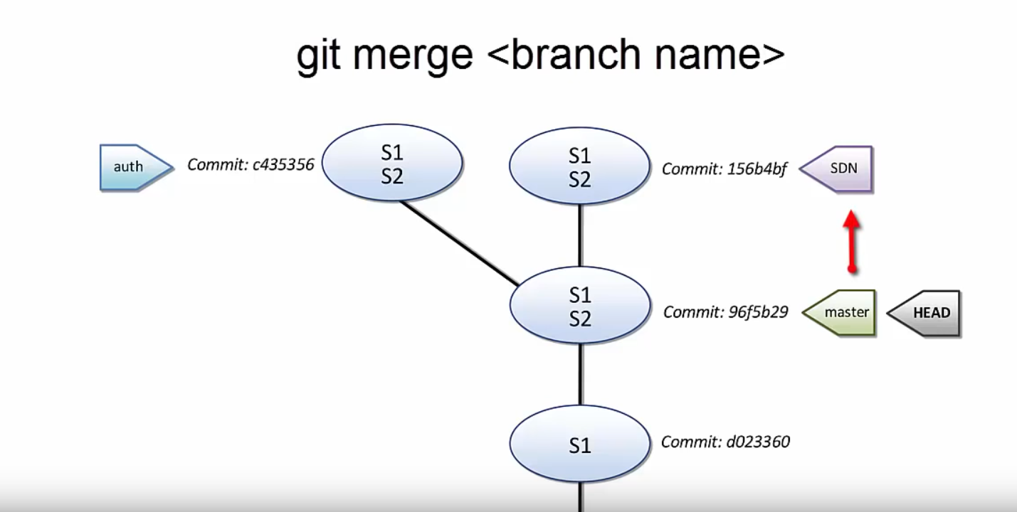
Git Branching

Slide 32
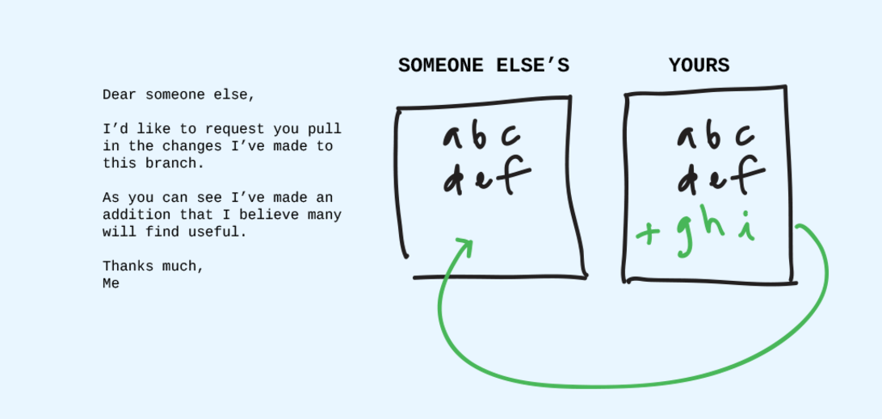
Pull Requests

Slide 33

Staging area
Courtesy: http://elledecoration.co.za/wp-content/uploads/2009/05/manufactum.jpg

Slide 34

http://rightrants.com/wp-content/uploads/2018/11/172b.jpg

Slide 35
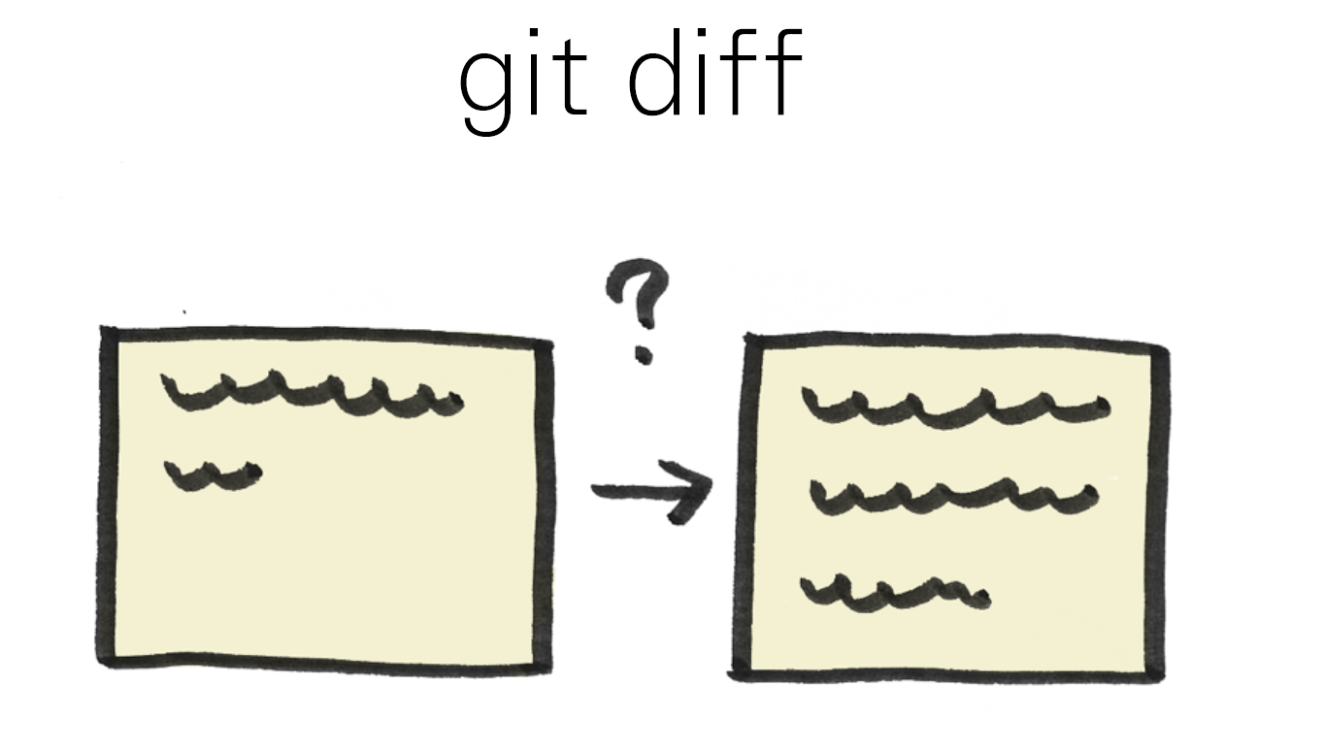
https://speakerd.s3.amazonaws.com/presentations/452113d0cb8c0131162302b4824706e4/20140601_github-kaigi-yunico.pdf

Slide 36
https://speakerd.s3.amazonaws.com/presentations/452113d0cb8c0131162302b4824706e4/20140601_github-kaigi-yunico.pdf

Slide 38
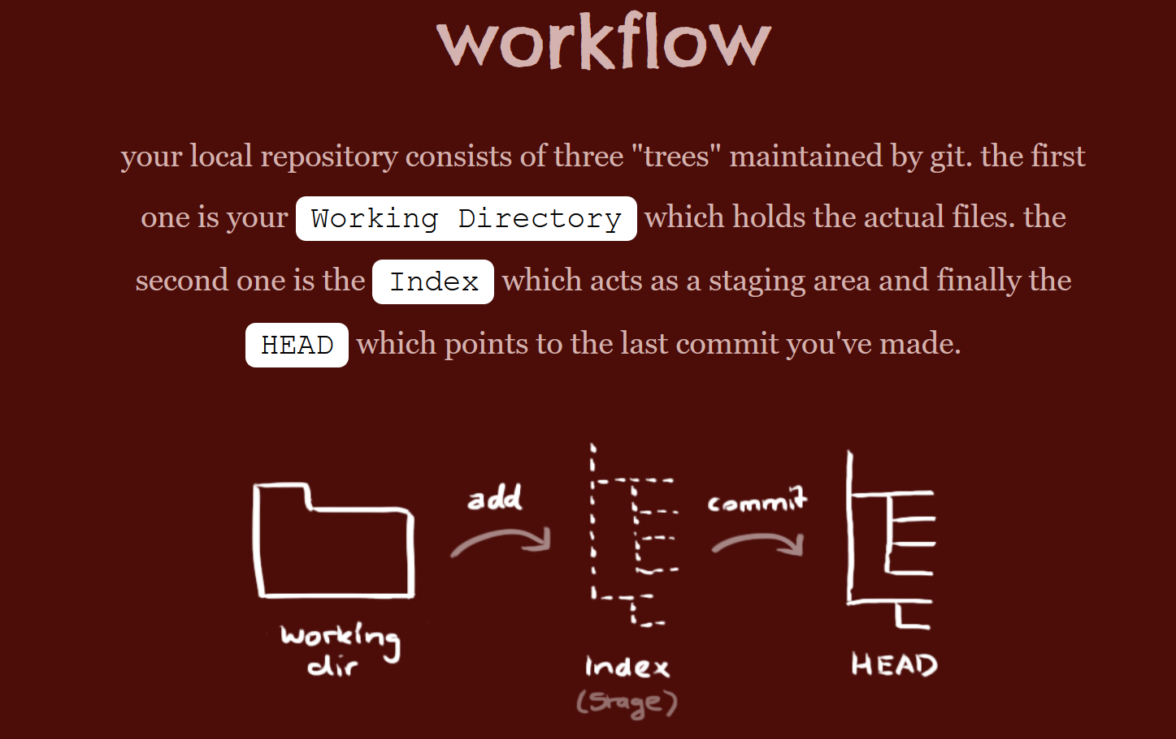
http://rogerdudler.github.io/git-guide/

Slide 39
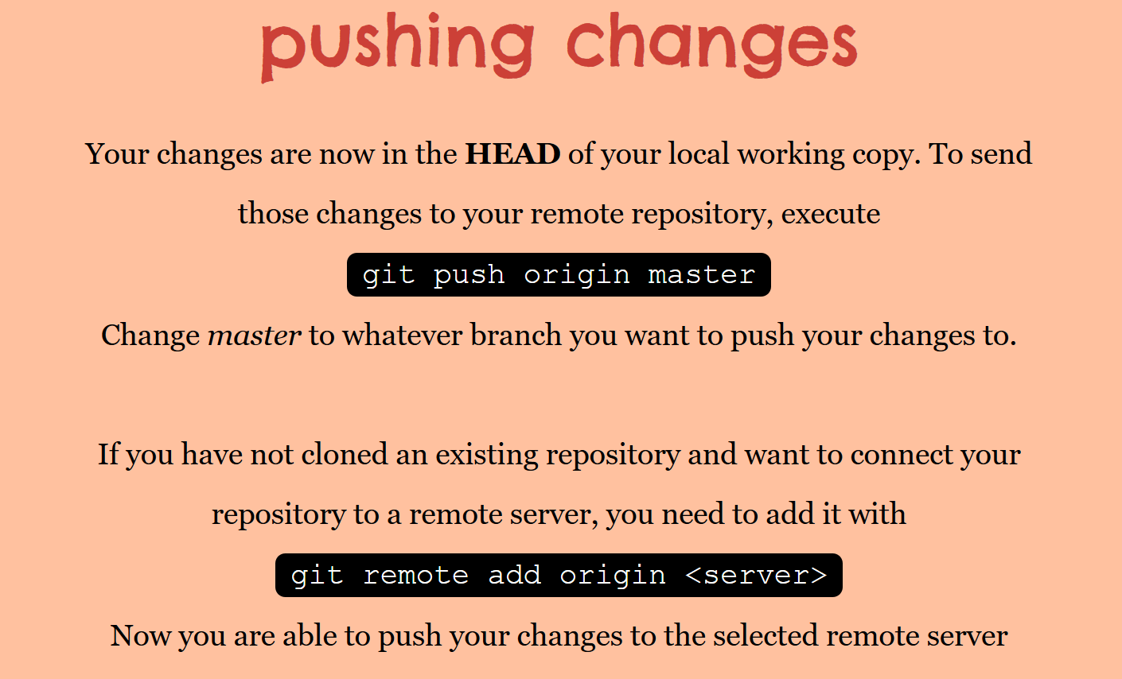
gpom

Slide 40
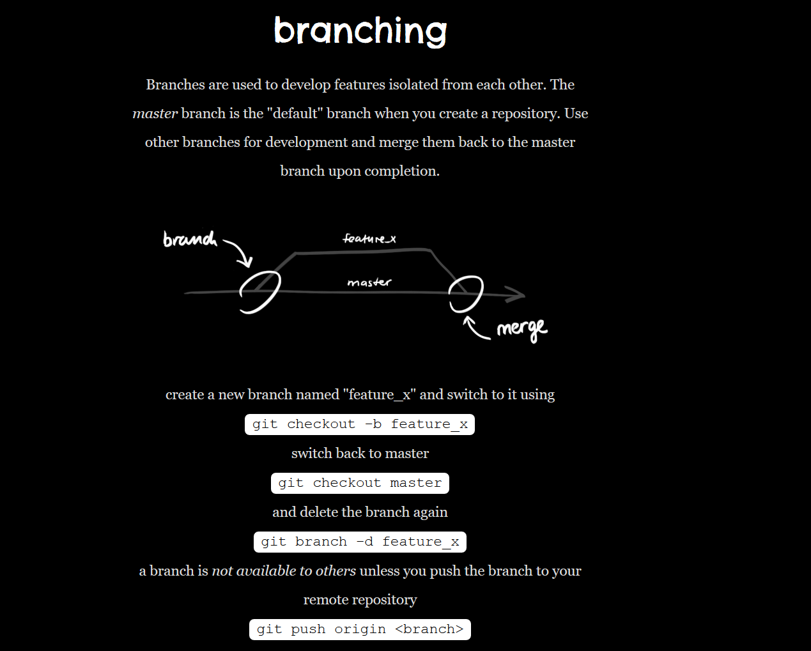

Slide 41
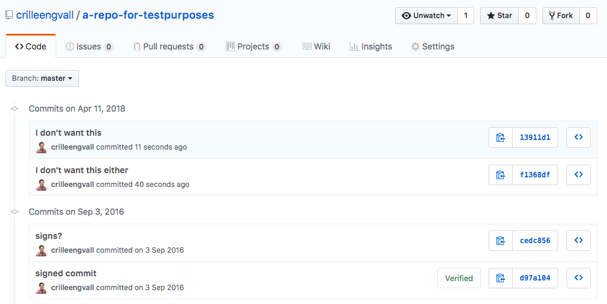
Unroll changes..

Slide 42
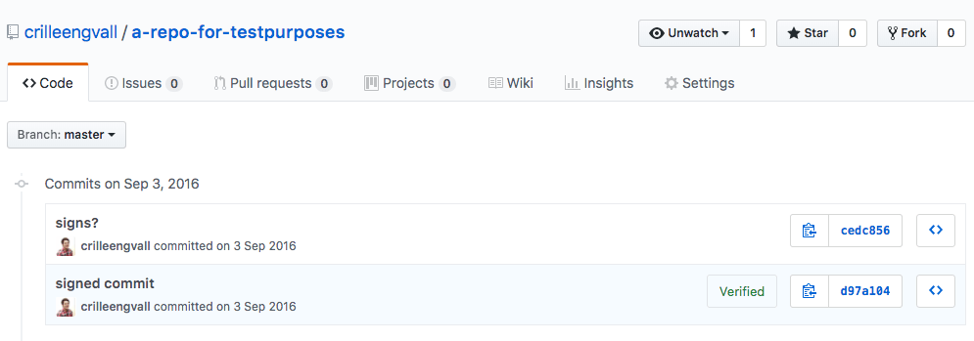
git reset --hard cedc856 git push --force origin master Then use git reset –hard <commit-hash> to set the current branch HEAD to the commit you want.

Slide 43
git log --all --decorate --oneline –graph alias graph =“git log --all --decorate --oneline –graph”

